Slide 1


Sap ABAP on Hana &
s/4hana trainings
Anubhav Oberoy

Slide 2

INTRODUCTION

Slide 3
Agenda – Day 2
New ABAP Syntax
Inline data declaration
Dynamic memory references
SQL Statement with escaping of host variables
SQL Enhancement
Introduction to DML, DDL, DCL, DQL.
Describe EPM Data Model
ABAP connect to HANA
Understanding HANA Folder Structure
Elaborating Design Time Object
Describing HANA Basics
---Break---
Showing Migration to SAP HANA as well as S/4 HANA
Describing Any Database Migration to HANA Database
ATC ( ABAP Test Cockpit ) v/s SCI ( SAP Code Inspector )
S/4HANA Code Conversion

Slide 4
New ABAP Syntax
SQL Enhancement
New ABAP syntax
Now we can use comma separated fields
We can use literals inside of sql queries
We can use the arithmetic operations
We have new SQL functions to perform logic
Case Expression can be added
We have now option to mark host variables in the select query – Escaping of host variable
Inline data declaration data()
String Expression
Create object
Value/Constructor Expression
Corresponding #
Table Expression

Slide 5

SQL Enhancement
With the introduction of NW AS ABAP 740 SPS5, the New enhanced extended Open SQL was introduced. The new enhanced open sql has some good features such introduction of aggregate functions, right outer join, casting, etc making it a starting step for Code-Push down paradigm
Exercise 1

Slide 6
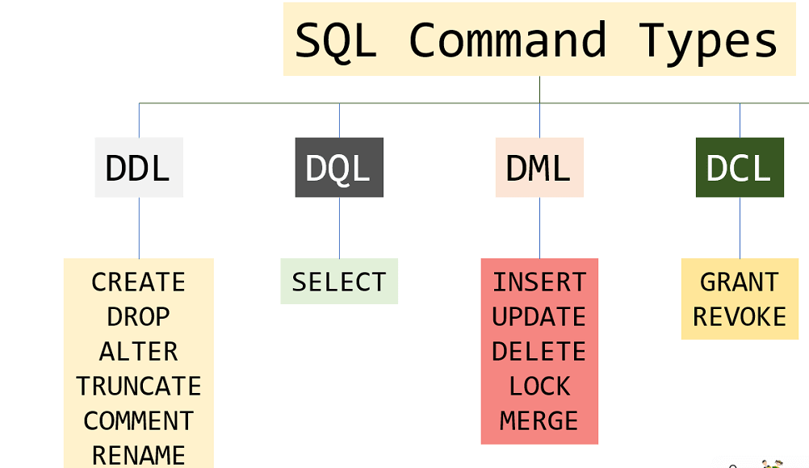
Introduction to Commands

Slide 7
Describe EPM Data Model
Real-time like demo data model which includes database tables, FMs, classes, Scenarios for training purpose and very much similar to real-life.
Products
Texts
Sales Order Header
Items
10 Laptops
3 HDD
5 Projectors
Purchase Order Header
Items
100 Laptops
300 HDD
50 Projectors
….
ITeIO
Electronics goods supplier (Amazon)
Customers (BP)
Suppliers (BP)
Invoice
Invoice Items
6 laptop
3 HDD
2 Projector
Stock
Invoice Line Item <= Sales Order Line item
6 laptop
3 HDD
2 Projector
Notes:
The sole purpose of an R/3 system is to provide a suite of tightly integrated, large-scale business applications. R/3 comes prepackaged with the core business applications needed by most large corporations. These applications coexist in one homogenous environment. They are designed from the ground up to run using a single database and one (very large) set of tables.
Presentation: It is usually installed on a user's workstation. When started, the presentation server displays the R/3 menus within a window. This window is commonly known as the SAPGUI, or the user interface (or simply, the interface).
Basis : Basis is like an operating system for R/3. It sits between the ABAP/4 code and the computer's operating system. SAP likes to call it middleware because it sits in the middle, between ABAP/4 and the operating system. ABAP/4 cannot run directly on an operating system. It requires a set of programs (collectively called Basis) to load, interpret, and buffer its input and output. Basis provides the runtime environment for ABAP/4 programs.
Database: The database server is a set of executables that accept database requests from the application server. These requests are passed on to the RDBMS (Relation Database Management System). The RDBMS sends the data back to the database server, which then passes the information back to the application server. The application server in turn passes that information to your ABAP/4 program.

Slide 8
HANA Folder Structure
In HANA also, to develop any of the HANA development objects we need Package. A package is a storage location of HANA design time objects. Calculation views, attribute, analytic views, hdbdd, hdbcds, hdbsequence….
Why?
Group things
Transport → Delivery Unit via package, you cant move content from D->Q->P
Package provides a namespace to the runtime objects – ANUBHAV ----activate---→ pkg::anubhav
Package in HANA provide security to make sure who can develop inside that package.

Slide 9
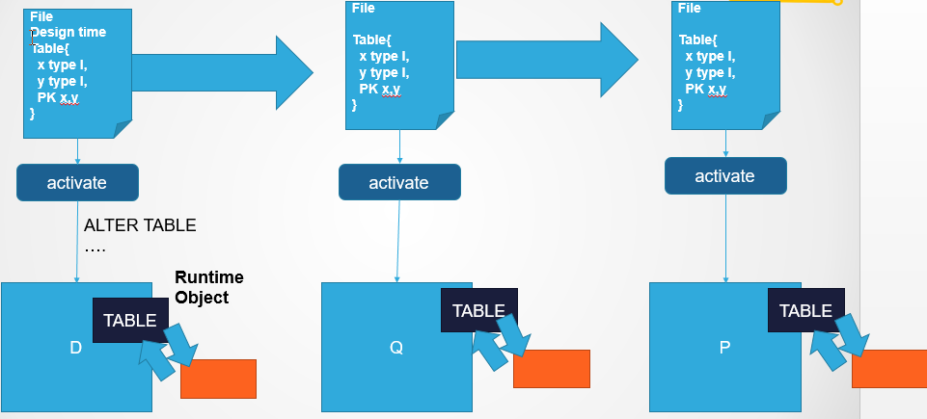
Design Time Object
The object can be project, package, schema, procedure, data models, etc. All the development objects built into SAP HANA are stored in a system called HANA Repository which is a storage system. The design-time environment's central component is SAP HANA repository which stores and manages all design-time objects.

Slide 10
HANA Basics
A Schema is a MANDATORY RUNTIME Object which existing in HANA DB. This is home of other runtime objects like tables, view, structure, procedure…..
All the schemas are stored under a node called catalog. There is a dedicated schema for ABAP system in HANA DB, which we can check in System Status.
-- Schema is mandatory object
-- When we create a user inside HANA DB, a schema with same name as user name will be created automatically
-- Schema also provides security at object level
-- When we develop objects in our local package in HANA and activate the runtime object will be created in our local schema

Slide 11

Break

Slide 12
Migration to HANA
A
B
C
ABAP
Business Suite
ABAP S/4HANA
ABAP
Non HANA
Any DB
HANA
HANA
Our company is migrating just the database
1. Basis – just like any other DB Migration, Data provisioning of all DB tables which are client independent. SUM
As an ABAP Developer, whether the custom code written by developers will work or not?

Slide 13
Any Database to HANA Database
1. Native SQL statements written in old DB will not work
EXEC SQL.
SELECT OrdNo……..
OPEN CURSOR….
END EXEC.
‘%_HINTS MYSQLNT ‘&prefer_join0&’
DELETE ADJUCENT DUPLICATES
READ TABLE itab BINARY SEARCH
Spurious Data
3000+ Programs, 6k FM, 8k Classes, 500 Includes, ….
Code Inspector – SCI
ABAP Test Cockpit – ATC – integration with ADT
SAP introduced a new variant – FUNCTIONAL_DB (Before you move)
2. DB specific hints provided to system to indicate indexes
3. When we read data from DB in non-sorted form and perform a
4. Direct access to Pool and Cluster table
5. Checks to DB specific Secondary index

Slide 14
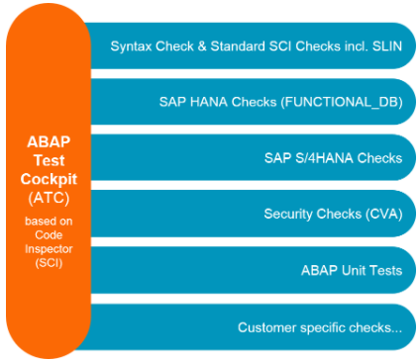
ABAP Test Cockpit ( ATC )
ABAP Test Cockpit (ATC) is an SAP new tool for ABAP programs quality checking. ... The ABAP Test Cockpit is directly integrated into the ABAP workbench as well as in the ABAP Development Tools for Eclipse and allows checking code from just within the development environment the ABAP developer is used to.

Slide 15
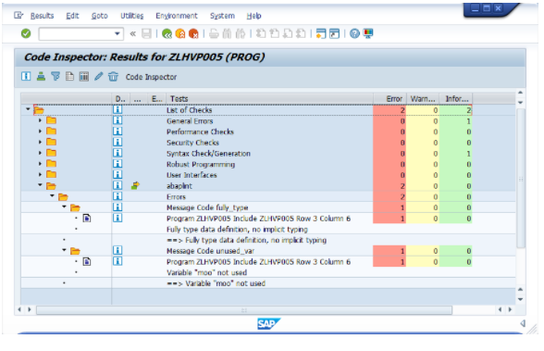
SAP Code Inspector ( SCI )
The Code Inspector is a tool for checking Repository objects. Using the Code Inspector, we can check individual objects or sets of objects for performance, security, syntax, and adherence to name conventions.

Slide 16
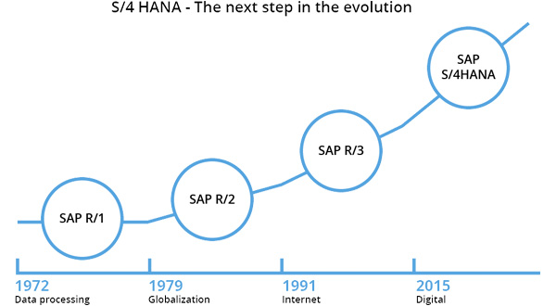

Slide 17
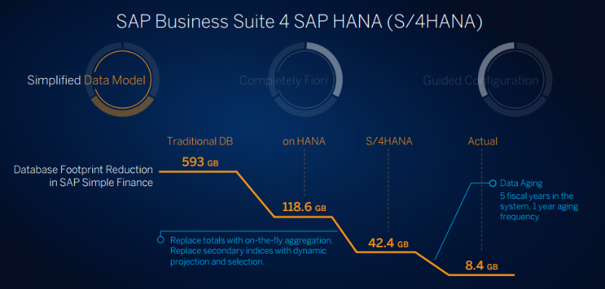

Slide 18
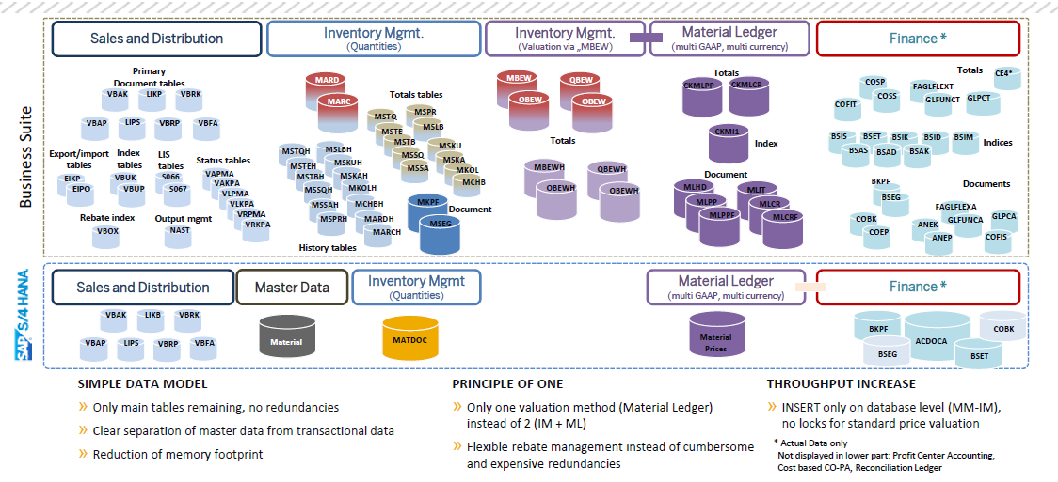

Slide 19
What About My Custom Code

Slide 20
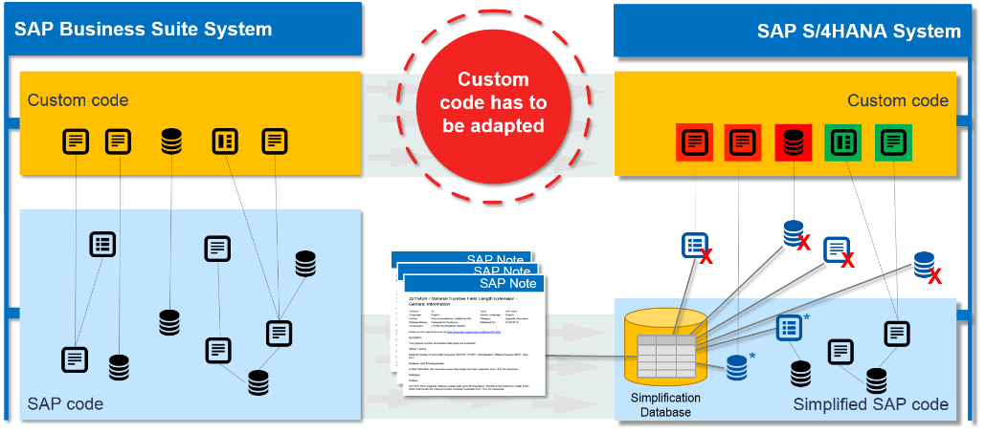

Slide 21
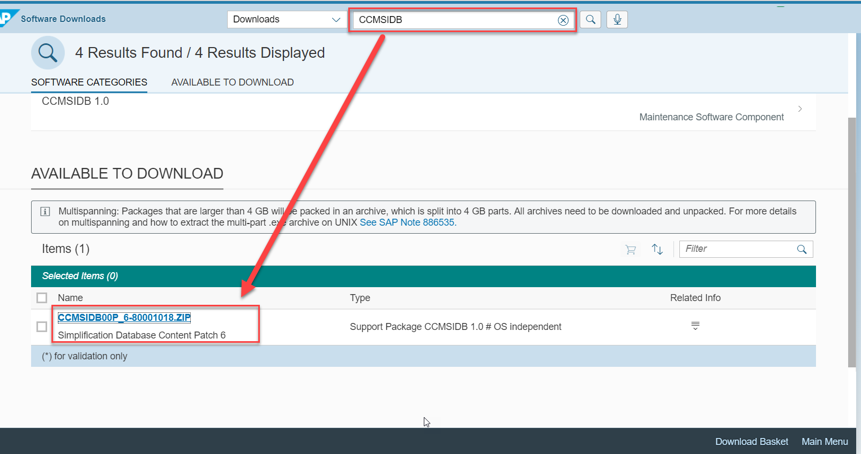

Slide 22
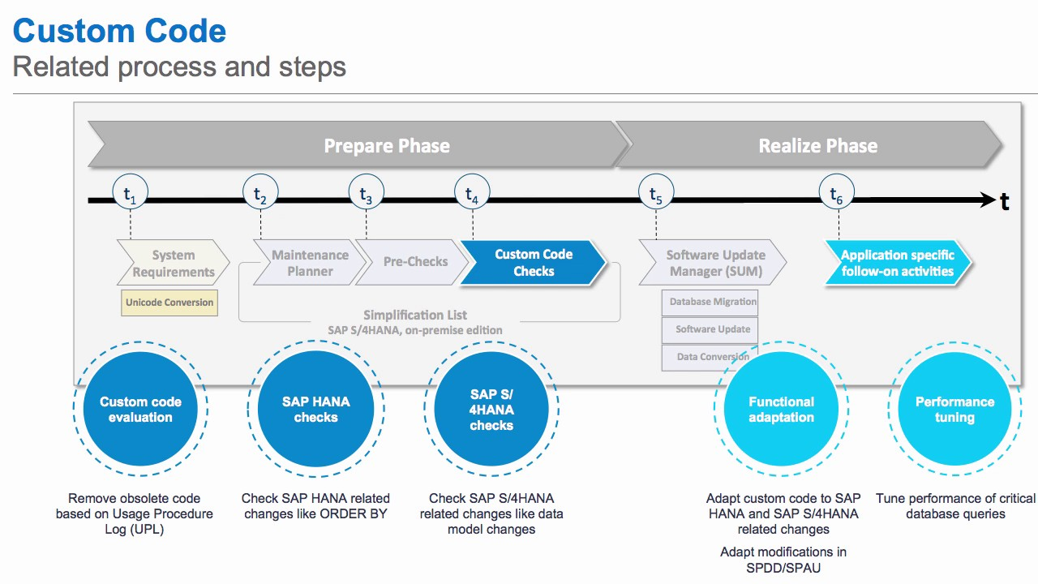

Slide 23
Feedback
AnubhavTrainings.com :
https://www.anubhavtrainings.com

Slide 24
End of Day 2

Slide 25

Questions

Slide 26

Anubhav Oberoy

